Slide 1
refactoring

Slide 2
Refactoring
Summary
Bad names / misterious names
Apply refactor and change the name
Repetitive code
Extract method
Large classes
Identify repetitive code
Move non suitable code to the right class
Move all validating methods from Hotel Manager (SOLID principles)
Take validation methods to Hotel_stay and Hotel_reservation
Use constructor method and setter to call validation methods
Create a new class (abstract) and subclasses

Slide 3
Refactoring
Summary
Steps to refactor
Make individual changes.
Run the tests until they give OK.
You can use pyb run_unit_tests which is faster.
It is possible that the code reorganization tasks themselves involve updating or defining and implementing new test cases.
Commit & push.
By doing commit and test for each change it will make it easier for the code to continue working

Slide 4
Refactoring Process
Summary
Steps
Code before refactoring
In the Hotel Manager class is the code with the attribute validations
credit_card
room_type
dni (id_card)
localizer
etc
First step: Extract methods and remove
mysterious names
validate_credit_card
validate_room_type
validate_phone_number _
etc
Second step: Extract classes

Slide 5
Refactoring Session II
Part I

Slide 6
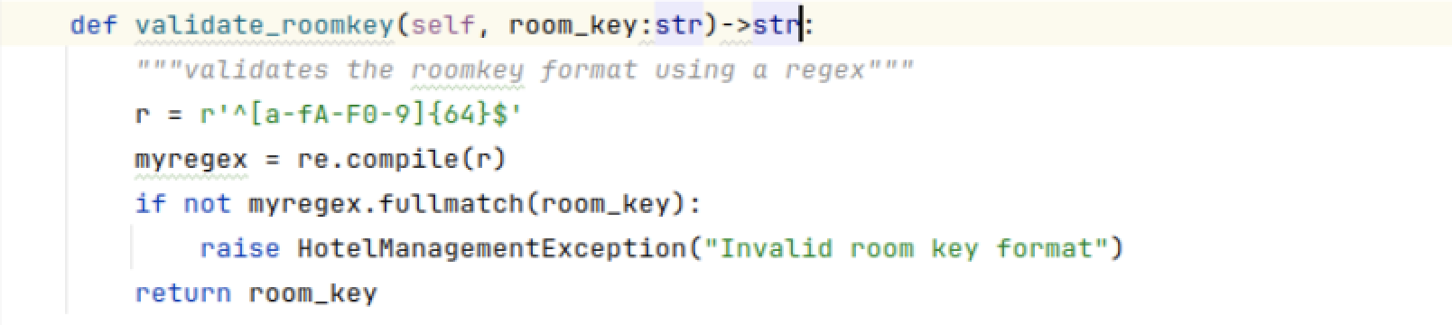
Refactoring Process
Extract Classes
All validation methods have the same structure:
Attribute
Pattern
Exception
abstract class
Inheritance
class 1
class 2
class no

Slide 7
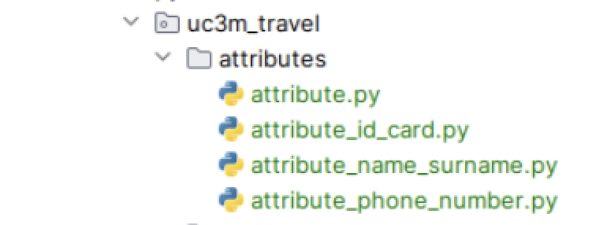
Refactoring Process
We create new classes for validations
Second step: Extract classes
Create generic class
Create a child class for each attribute
import the classes
Change the references
Make one change at a time
…

Slide 8
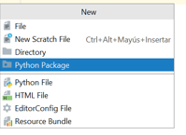
Refactoring Process
We create a generic class for the validations
We create a new package
File -> New -> Python Package
We create two new files
Generic class: attribute
Child class: attribute_phone_number

Slide 9
Refactoring Process
We create a generic class for the validations
Notice the repetitive structure and how we can use parameters to make it more flexible
def validate_phonenumber(self, phone_number): """validates the phone number format using regex""" myregex = re.compile(r"^(\+)[0-9]{9}") res = myregex.fullmatch(phone_number) if not res: raise HotelManagementException("Invalid phone number format") return phone_number
def validate_arrival_date(self, arrival_date): """validates the arrival date format using regex""" myregex = re.compile(r"^(([0-2]\d|-3[0-1])\/(0\d|1[0-2])\/\d\d\d\d)$") res = myregex.fullmatch(arrival_date) if not res: raise HotelManagementException("Invalid date format") return arrival_date

Slide 10
Refactoring Process
We create a generic class for the validations
Notice the repetitive structure and how we can use parameters to make it more flexible
Pattern
Error message
Returning value

Slide 11
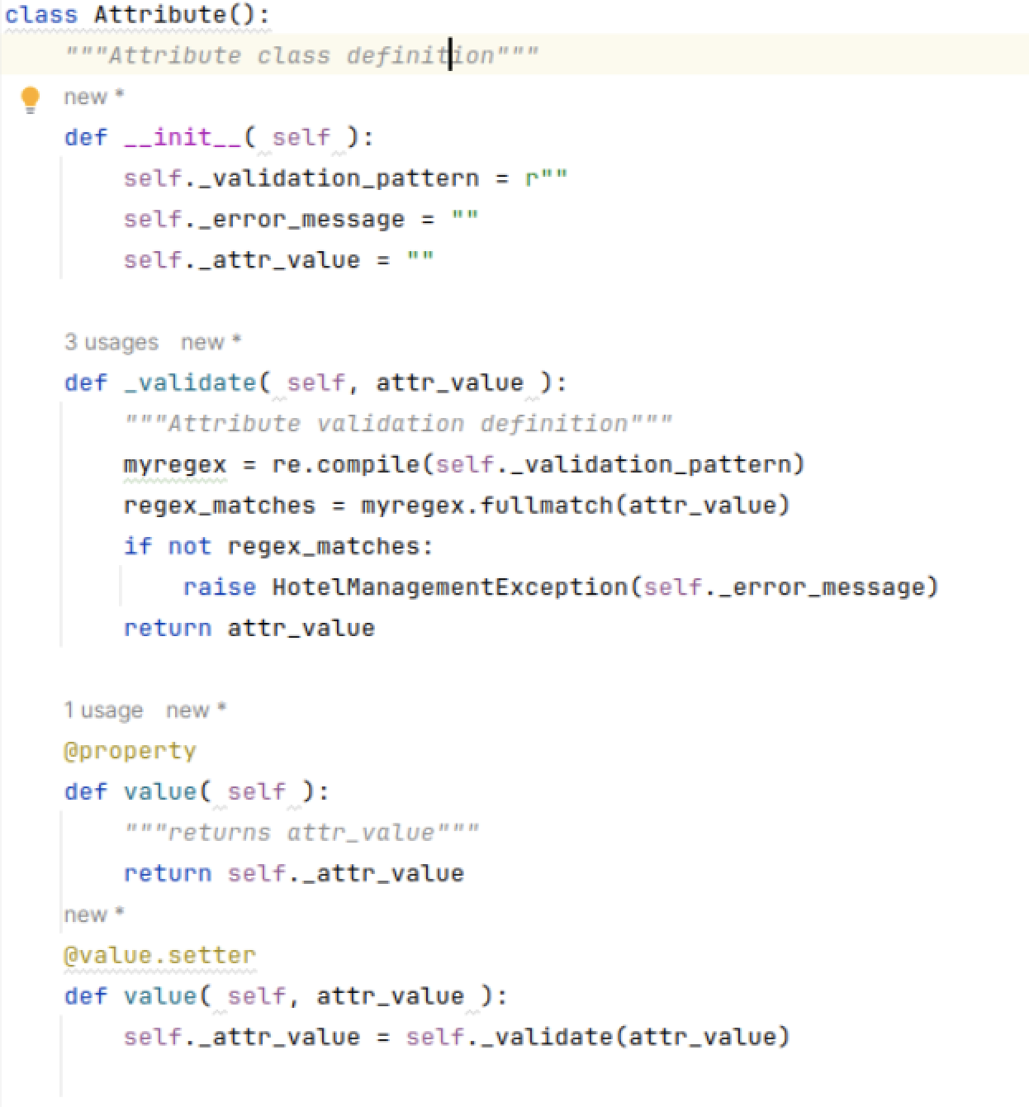
Refactoring Process
We create a generic class (abstract)
This is the
code we repeat different times. Now, we have only
one based on
parameters

Slide 12
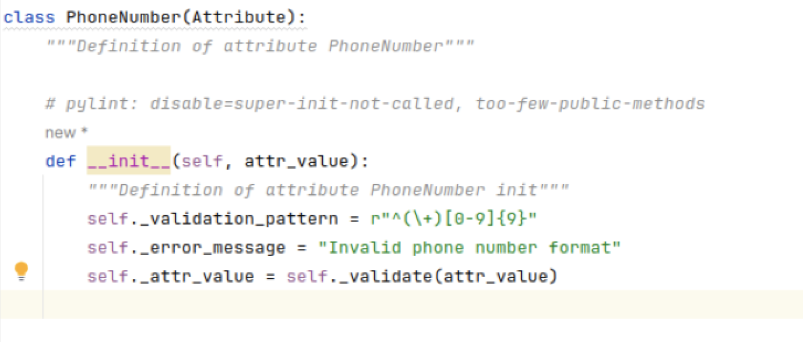
Refactoring Process
We create a child class to validate the concrete case
Class PhoneNumber , subclass of Attribute

Slide 13
Refactoring Process
Overload based methods
Sometimes a base class is not enough
Parameterizable structure cannot cover all the situations
We may need extra adaptations
Solution: Overload based methods

Slide 14
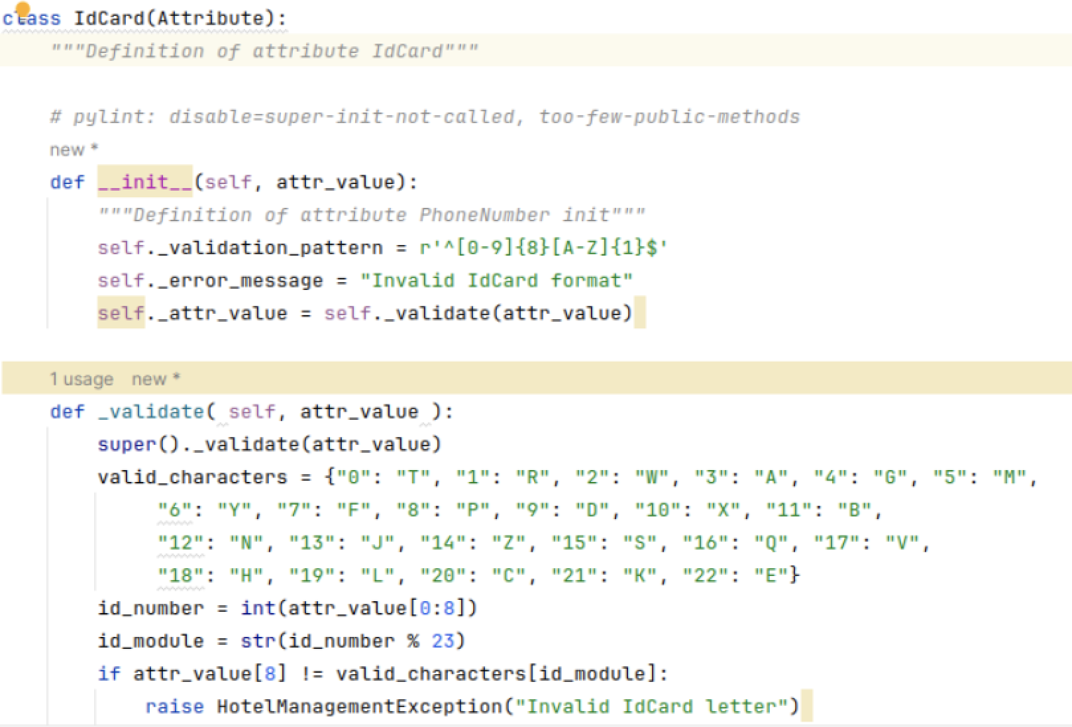
Refactoring Process
We create a child class to validate IdCards
(you need something similar with the CreditCard)
In case, base class doesn´t provide what we need this is the place where we should overload the base class method
First, we apply the basic methods that are applicable to all cases.

Slide 15
Refactoring Process
How to deal with JSON stores
JSON type files are read and written several times in the code.
We will create a class to handle the stores so that the functions of handling the storage files are all together.
This will allow us to see the similarities and see how we can organize them.
Once this is done, we can see that we can create a generic class to handle a type store, and then 3 child classes for the specific stores.

Slide 16
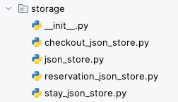
Refactoring Process
Creamos una nueva clase para los almacenes
Create a new Python package
File -> New -> Python Package
One we finish refactoring process we will have this files set
An abstract class
As many children classes as stores we manage in our code

Slide 17
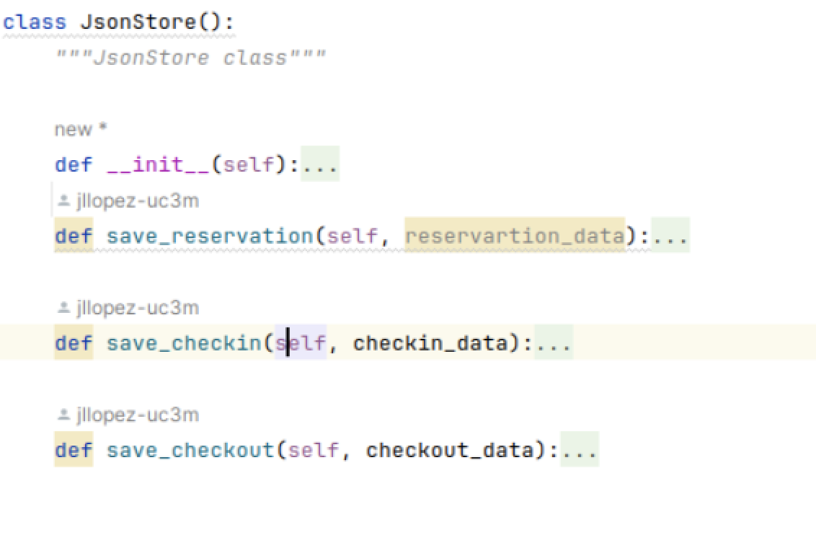
Refactoring Process
Steps for JSON stores
Move all the methods which are involved with stores in Hotel Manager class

Slide 18
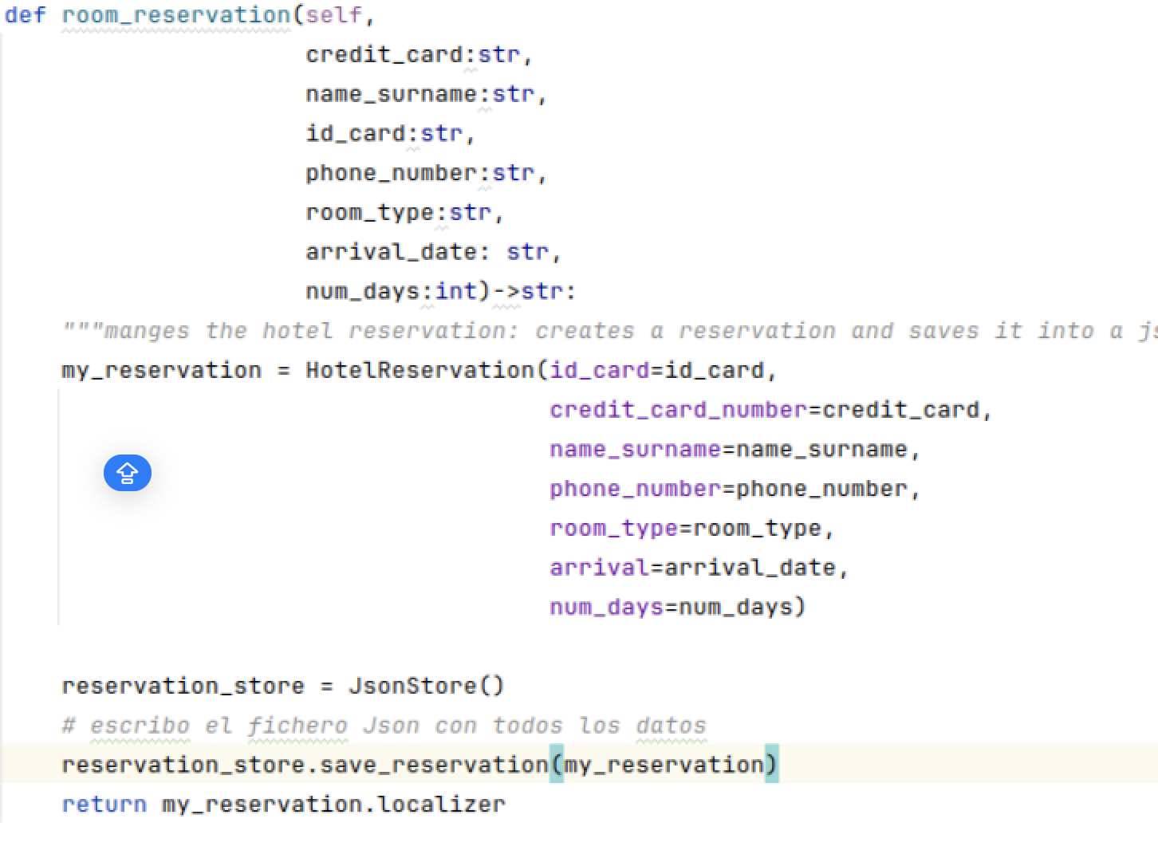
Refactoring Process
Steps for JSON stores
In HotelManager , replace all the call to store methods
Run test and check everything works

Slide 19
Refactoring Process
Steps for JSON stores
We continue moving the methods that manage the stores and replacing the calls.
Every time we run the tests do not forget to commit the changes.
We move the rest of the code related to the processing of json files
We extract methods, for example, in F2 (guest_arrival) we have code to search for a reservation in the warehouse.

Slide 20
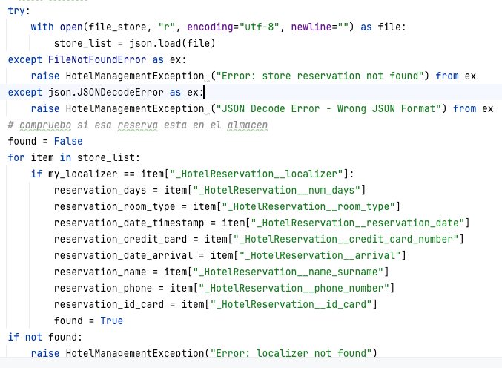
Refactoring Process
Steps for JSON stores

Slide 21
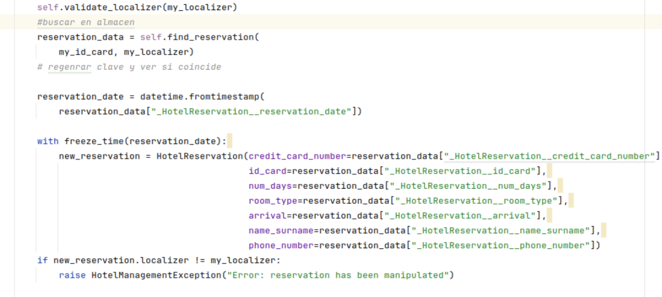
Refactoring Process
Steps for JSON stores
We move the new method to the class that manages the JSON stores

Slide 22
Refactoring Process
Steps for JSON stores
Once we're done extracting methods, moving them to the new class, and replacing calls -> we're going to refactor the class code because there will be a lot of duplicate code.
Basically, we have the same pattern in all the methods that record in the stores:
load or read the file
search a record
add a record
write the file

Slide 23
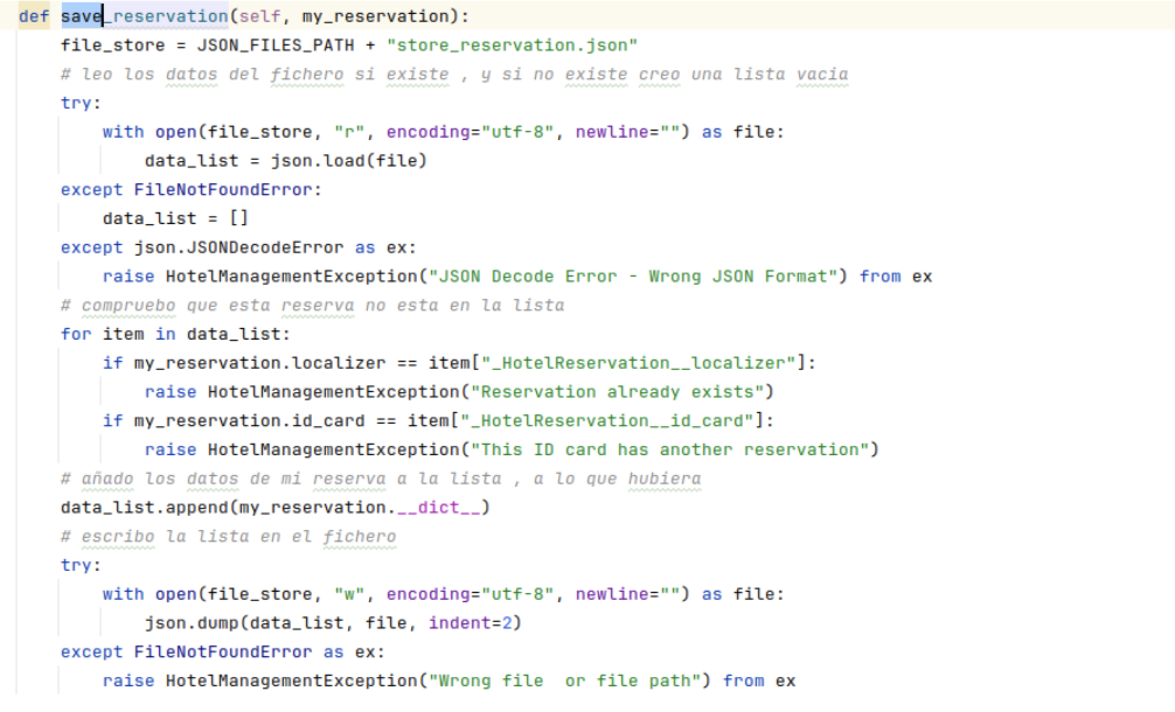
Refactoring Process
Steps for JSON stores
load_store
find_item
save_store

Slide 24
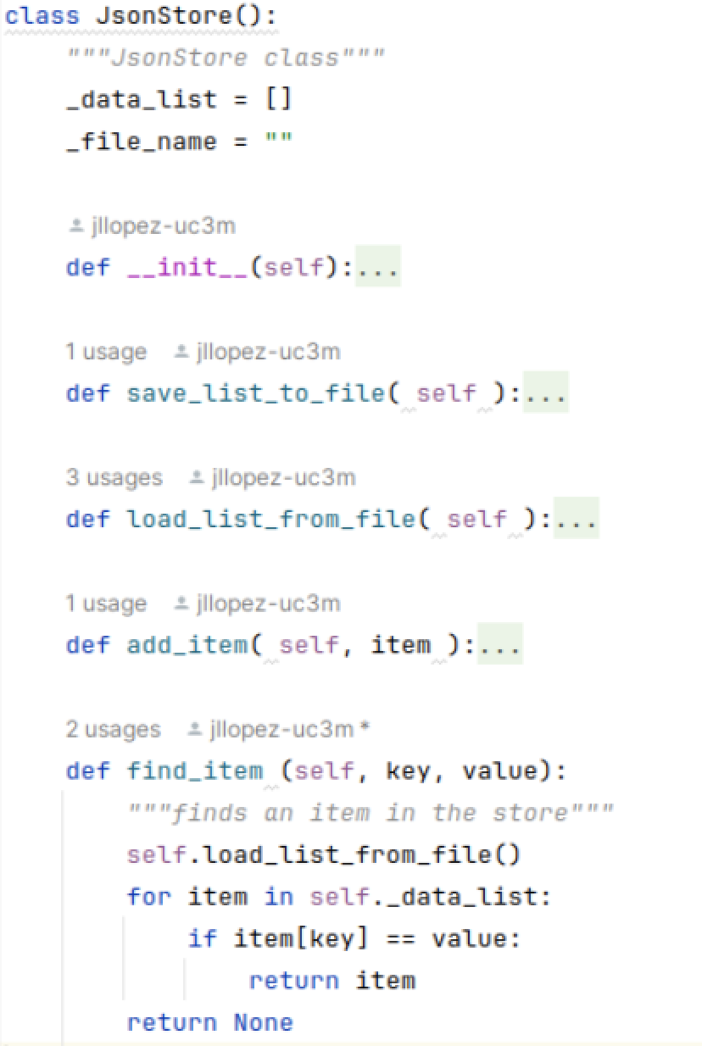
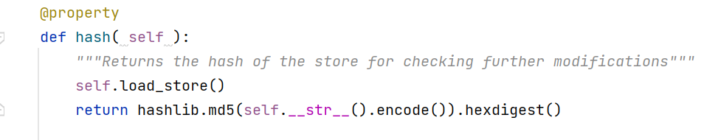
Refactoring Process
Create a new class for Stores
Our abstract class hasthe following methods at least:

Slide 25
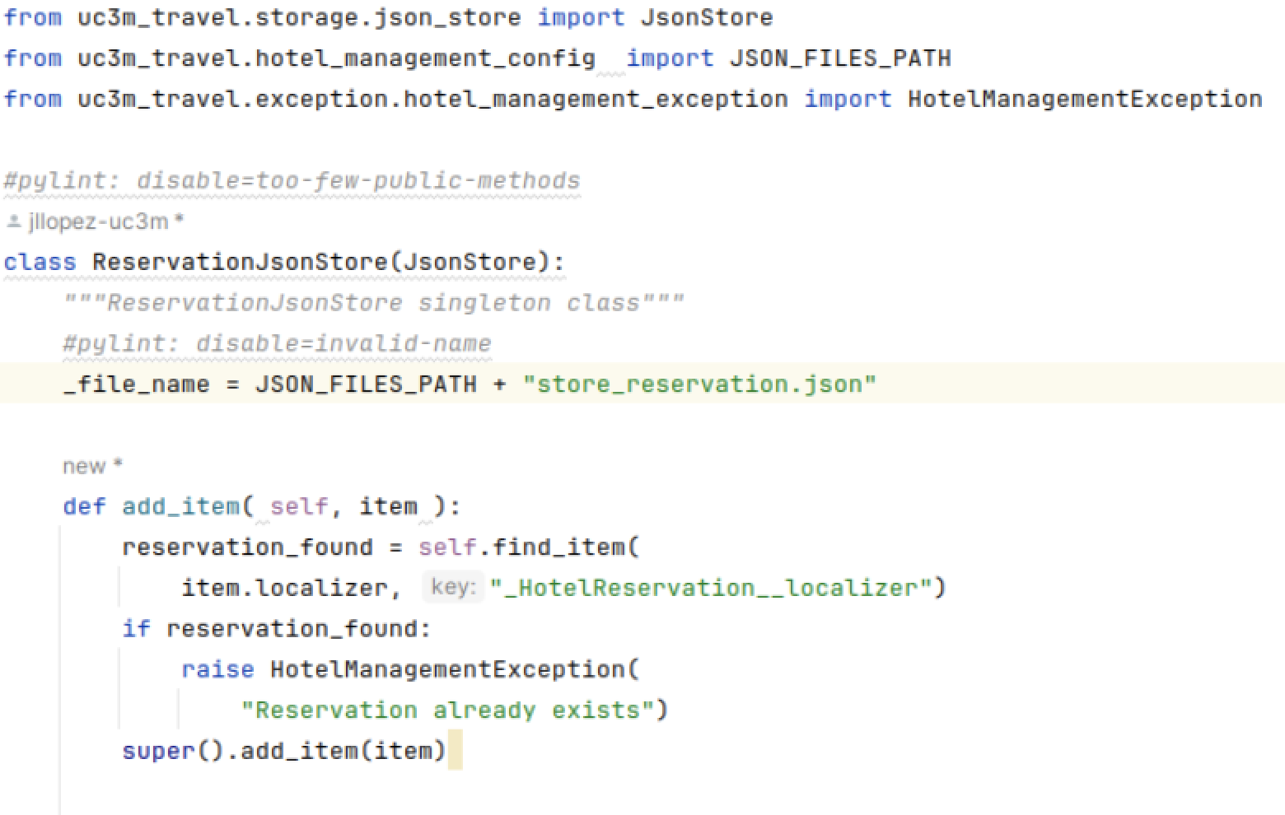
Refactoring Process
Create new children classes

Slide 26
Refactoring Process
Refactor F2 using a class method
Id_card, name_surname,credit_card, num_days…
Id_card, name_surname,credit_card, num_days…, localizer
localizer
room_reservation
RF 1
Generate the locator
Save the locator in the store
ReservationJsonStore
RF2
When the client arrives at the hotel:
The localizer is in the Json input file
Search reservation information with the locator
Check the locator
Generate the roomkey
Save the data to the checkin store
guest_arrival
localizer
idcard

Slide 27
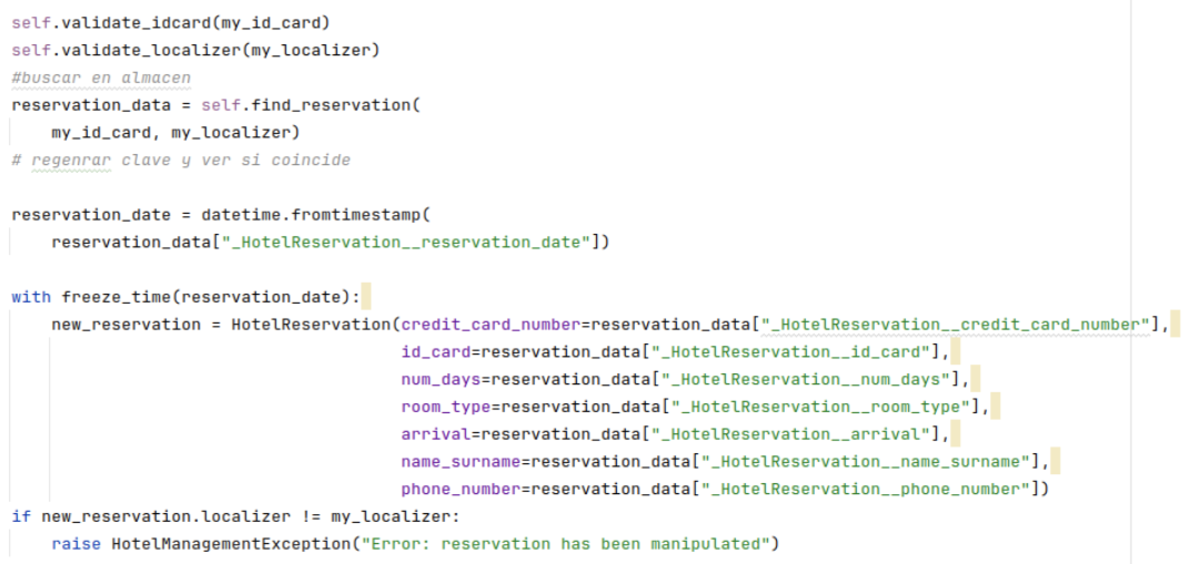
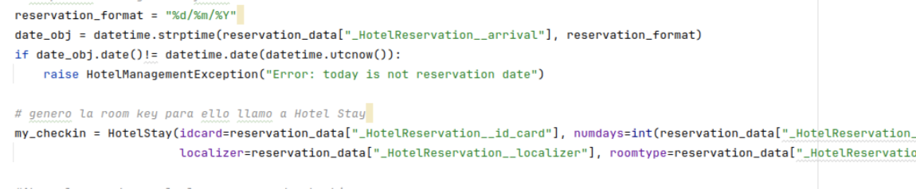
Refactoring Process

Slide 28
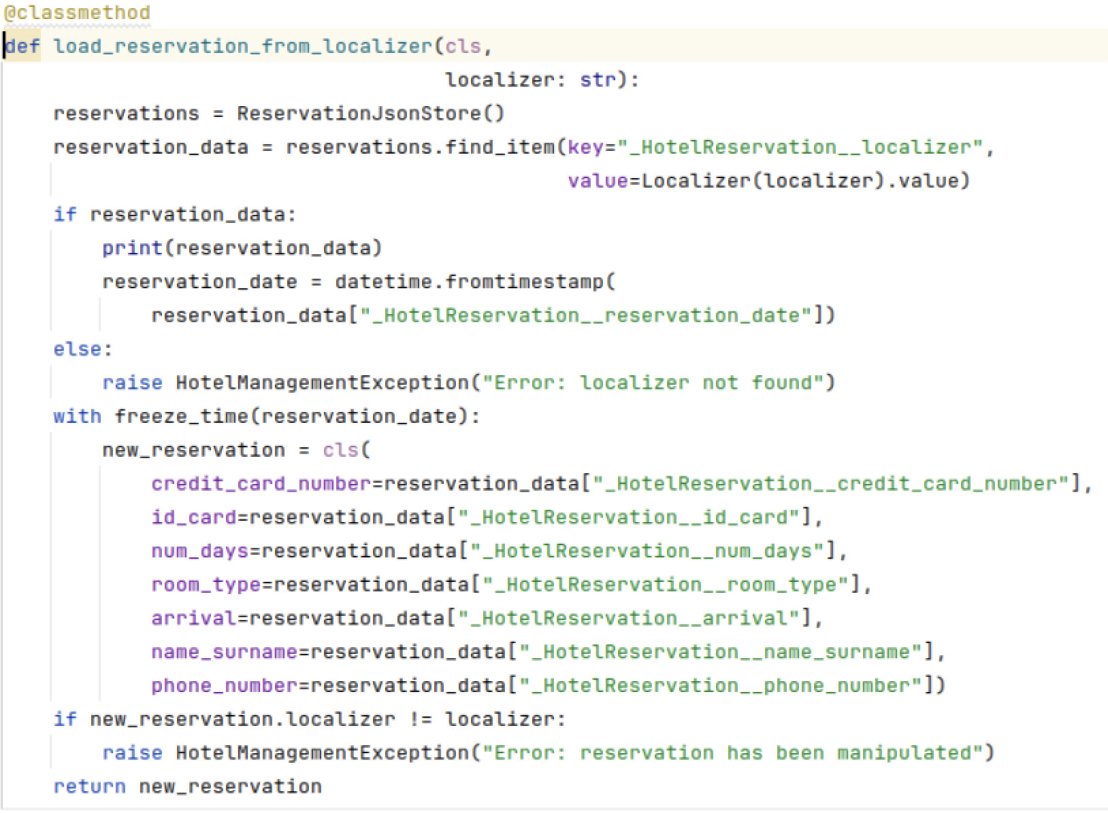
Refactoring Process
Steps
Define a method to read the input json file, extract the localizer and pass it to HotelReservation
Será un class method porque desde el mismo tengo que llamar a la clase. para ello usamos cls.
class method
You must put the @classmethod decorator
It allows to be called without creating an instance of the class.
You can access other methods and attributes of the class.
You do not have access to the instance attributes, since the instance was not created you cannot use them.

Slide 29
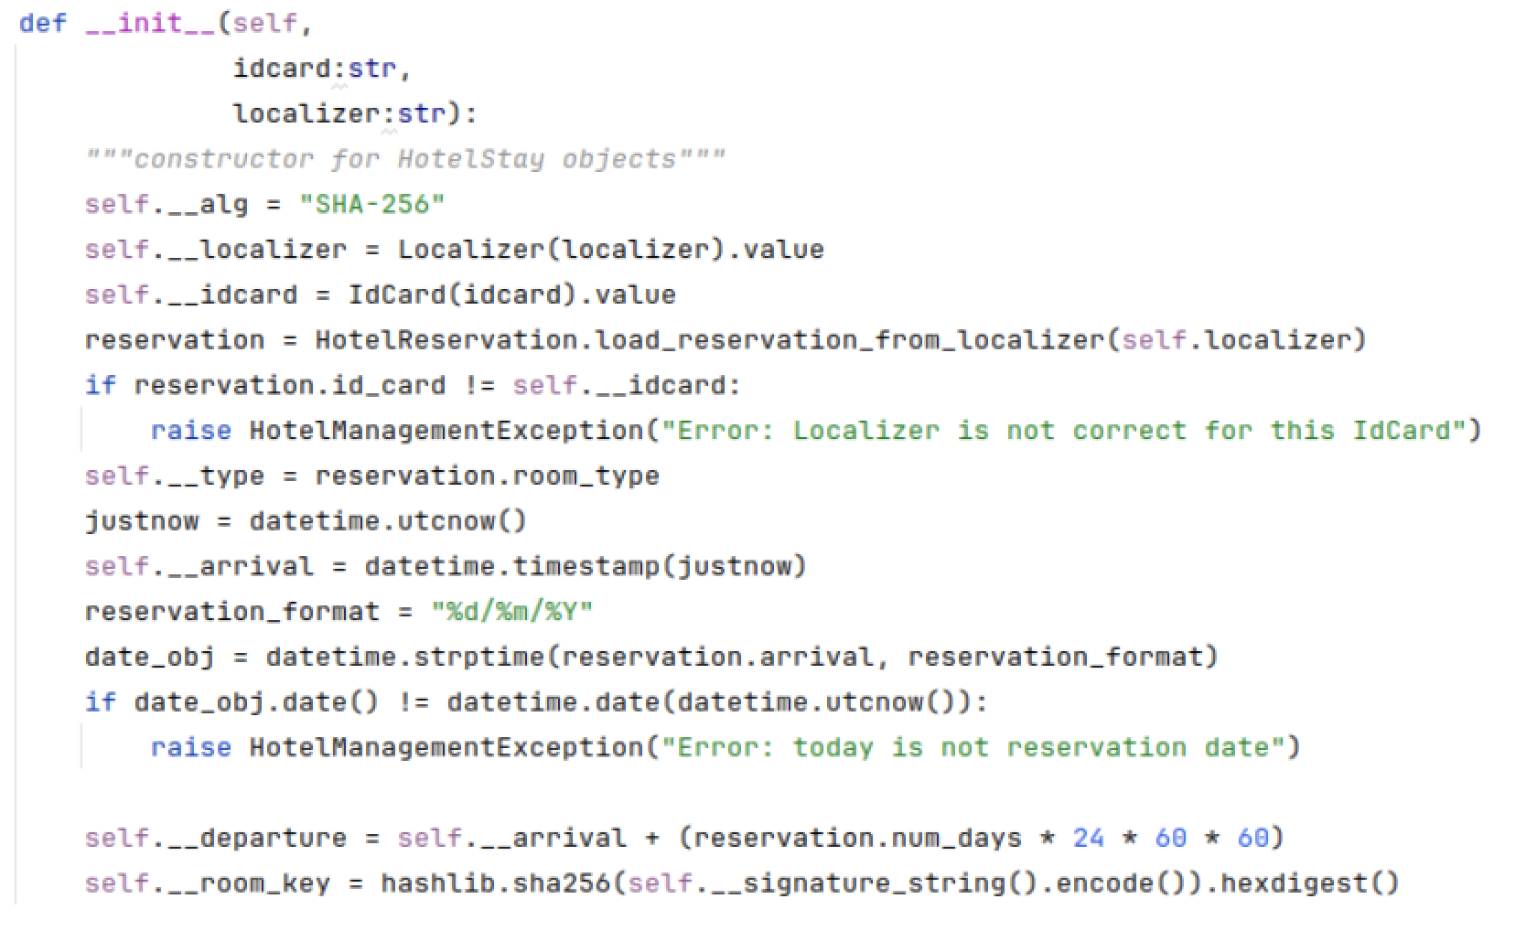
Refactoring Process
I use it in HotelStay -> I update __init__ method to receive localizer and id_card values (the rest of the client´s data I take from the booking store)

